Slide 1
AERMS
- Agriculture Equipment Rental Management System
BY-
Y. Manoj Kumar
P. Harsha Reddy

Slide 2

The Agriculture Equipment Rental Management System is a digital platform that connects farmers with equipment owner(Admin), enabling seamless rental services. It allows farmers to browse, book, and rent agricultural machinery at affordable rates. Equipment owner(Admin) can list their machines, manage bookings, and set rental prices.

Slide 3
Problem Statement
Farmers, particularly small and marginal farmers, often face challenges in accessing high-quality and advanced agricultural equipment due to the high costs of ownership. The lack of affordable options for accessing modern tools negatively impacts their productivity, efficiency, and overall yield. Many farmers resort to outdated methods, which can result in lower profitability and slower agricultural growth.
Additionally, equipment owners often struggle to efficiently connect with farmers in need of their services. The current process of renting or leasing equipment is mostly manual, fragmented leading to underutilization of resources.

Slide 4
Purpose Of The Project
The Agriculture Equipment Rental Management System Project is an innovative web-based application designed to bridge the gap between equipment owner(Admin) and users, primarily focusing on providing agricultural tools on rent. The platform is structured to serve both individual and business needs, offering a seamless experience for managing, booking, and renting essential equipment. By integrating modern technology with traditional agricultural practices, Agriculture Equipment Rental Management Project supports farmers and small businesses in accessing necessary tools without the financial burden of ownership.

Slide 5
ADMIN MODULE
Dashboard: A comprehensive overview of available products, booking details, and system activities.
Category Management: The ability to add, update, or delete product categories.
Product Management: Admin can manage the listing of agricultural equipment, ensuring the availability and quality of products for rent.
Page Management: The ability to update and maintain static content pages like “About Us” and “Contact Us.”
Registered Users: View and manage details of all registered users on the platform.
Booking Management: Admin can track, approve, or disapprove bookings, and view booking statistics.
Reports: Detailed reports on bookings and sales, allowing the admin to analyse performance over specific periods.
Search: A robust search feature to locate bookings by user name or booking number.

Slide 6
USER MODULE
Guest Users: Can explore the platform, view available products, and register for more features.
Registered Users: Have full access to booking details, account management, and personalized services.
My Booking: Track booking status, view costs, and print invoices.
My Account: Update profile information, manage passwords, and ensure account security.
Multi-Language Support: Supports different languages for wider accessibility.

Slide 7
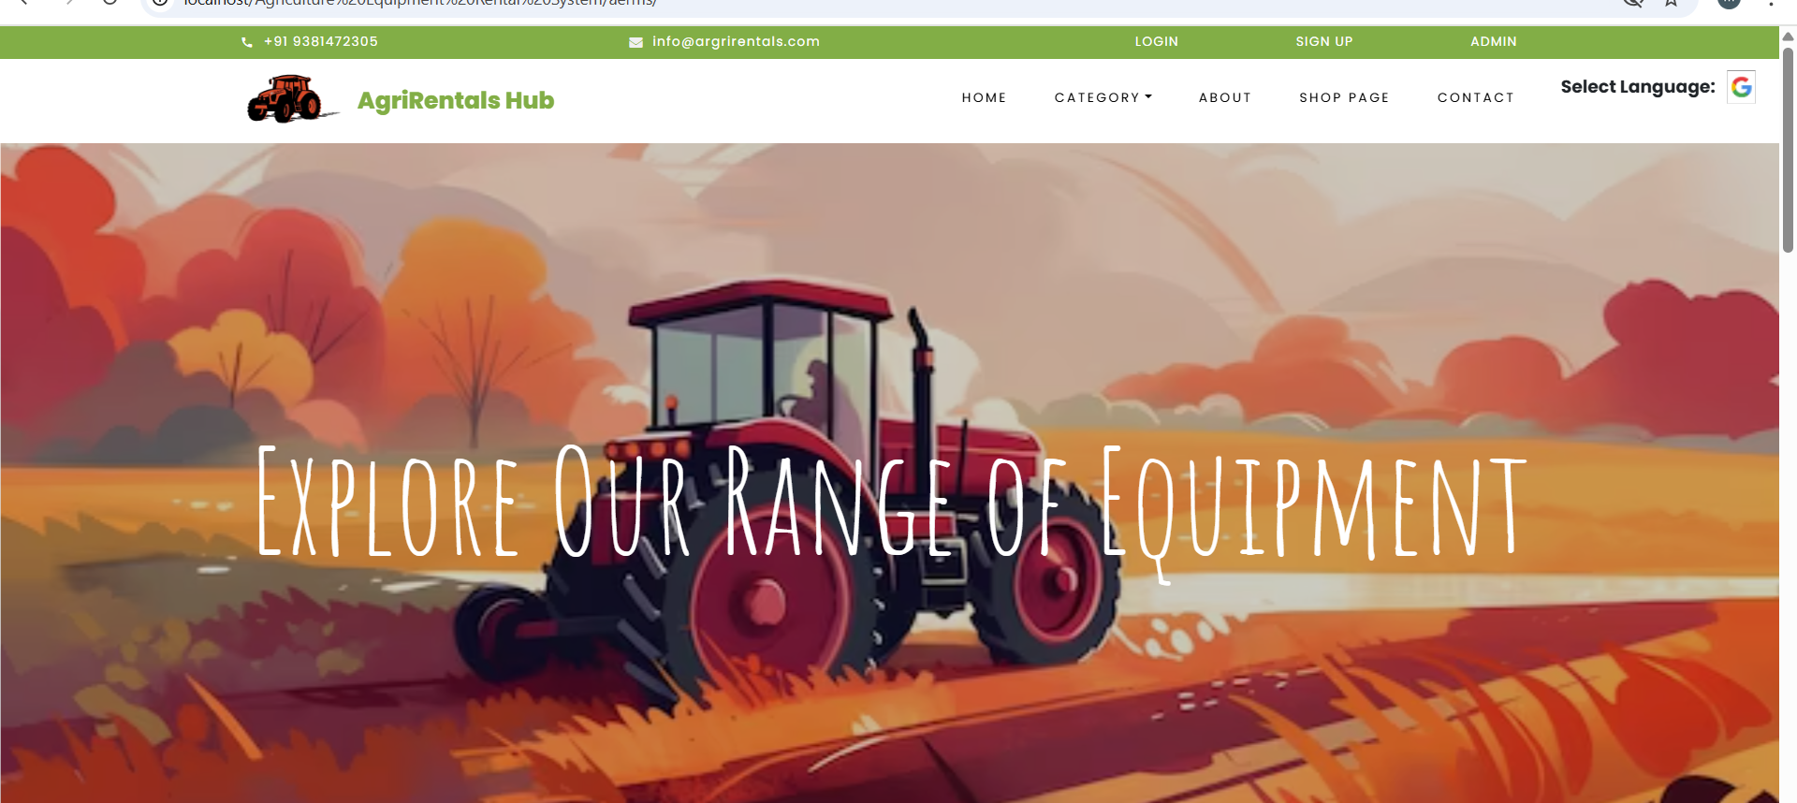
Home Page
This is the homepage of the Agriculture Equipment Rental Management System. It provides easy navigation for users to browse, rent, and manage agricultural machinery efficiently.

Slide 8
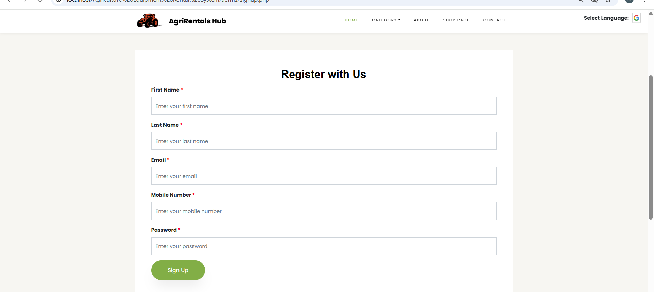
Sign-up Page
This is the sign-up page of the Agriculture Equipment Rental Management System. New users can create an account to rent or list agricultural equipment easily.

Slide 9
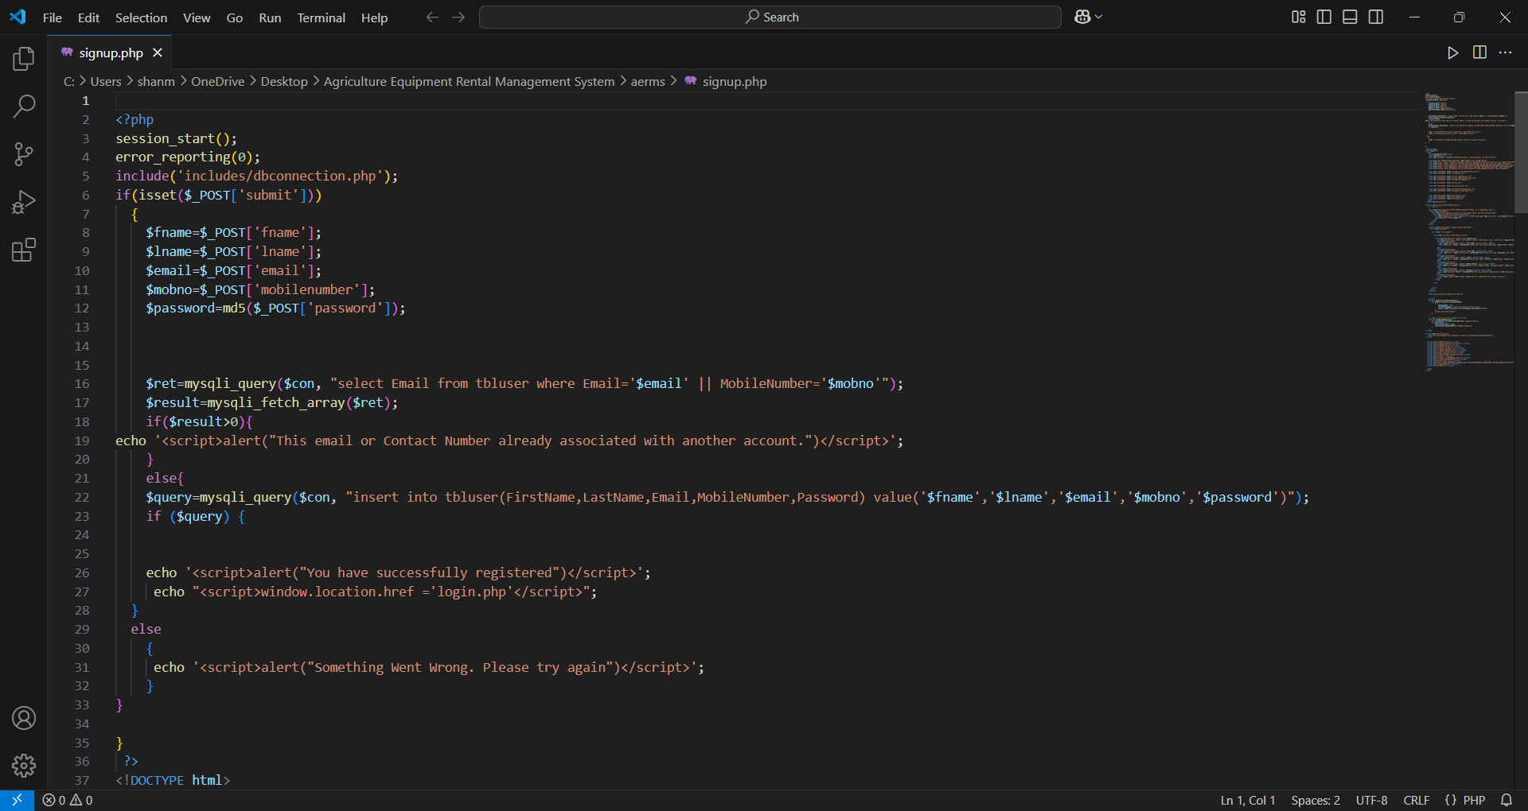
This is the code for sign-up page :

Slide 10
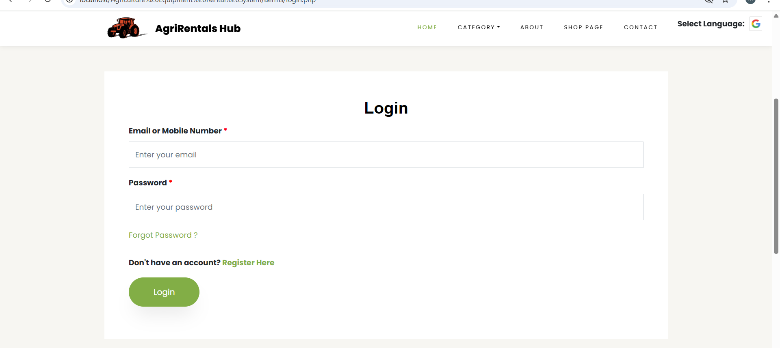
Login Page
This is the login page of the Agriculture Equipment Rental Management System. Users can securely sign in to access their accounts, manage equipment rentals, and track bookings.

Slide 11
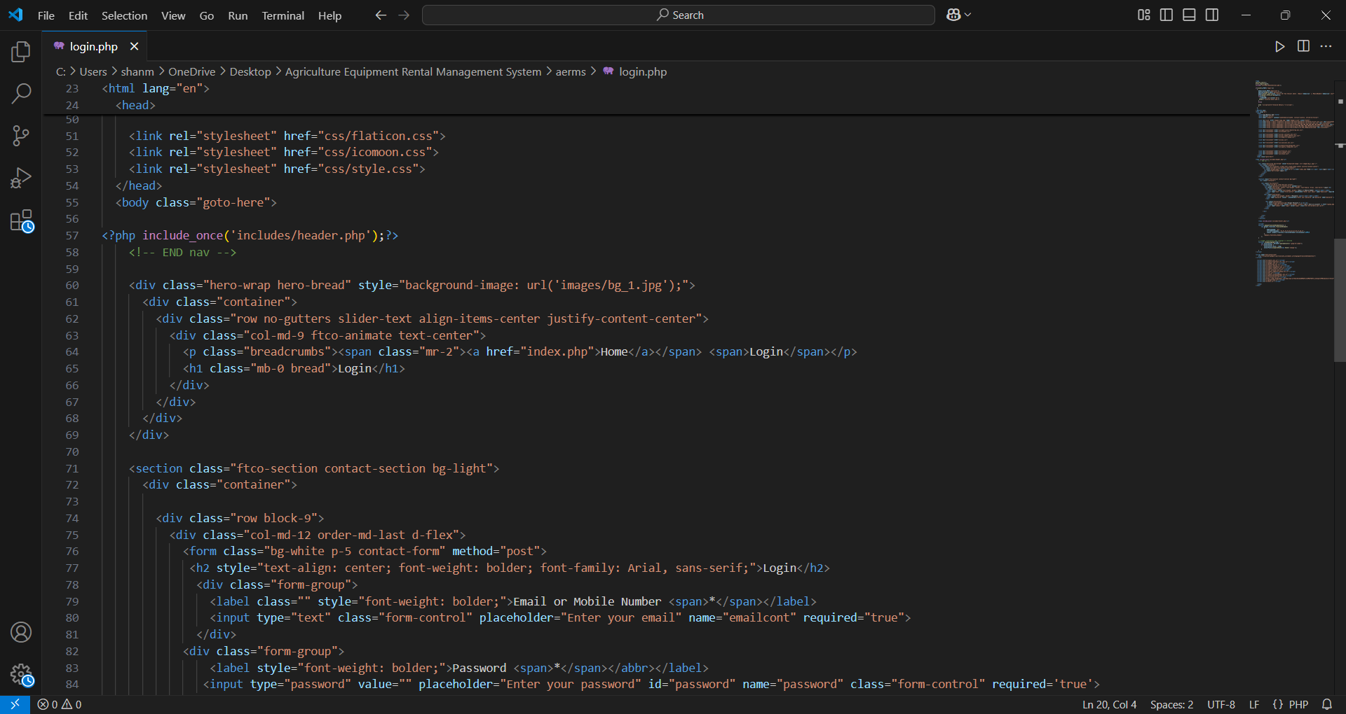
This is the code for login page :

Slide 12
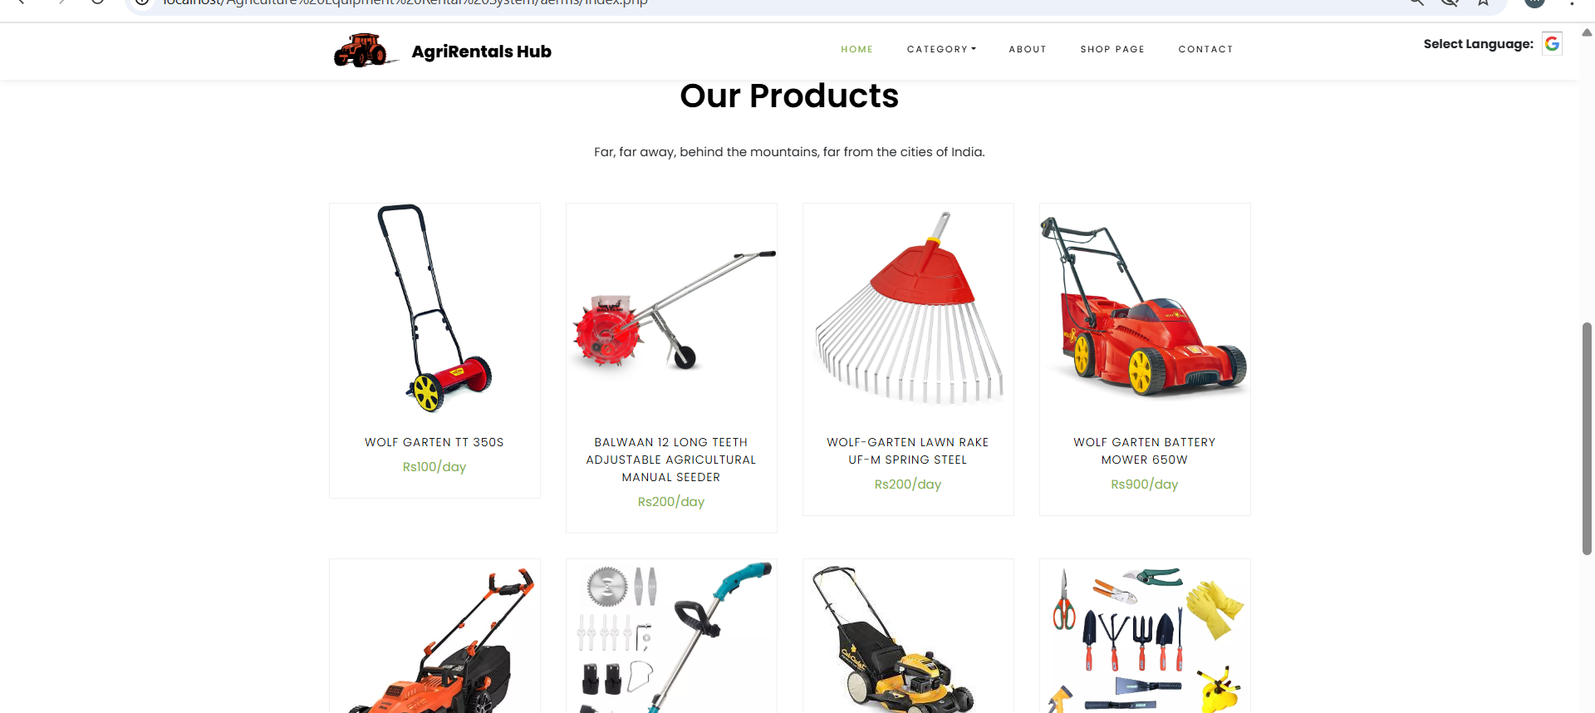
Products
This is the products page of the Agriculture Equipment Rental Management System. It showcases a variety of agricultural equipment available for rent, including tractors, harvesters, sprayers, hand tools and many more.

Slide 13
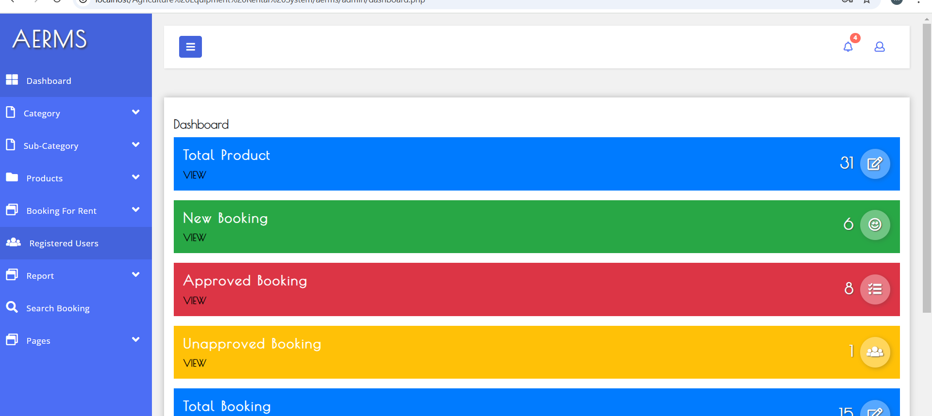
Admin- Dash Board
This is the admin panel dashboard of the Agriculture Equipment Rental Management System. It allows administrators to manage users, equipment listings, overview of bookings, registered users and rental status in one place.

Slide 14
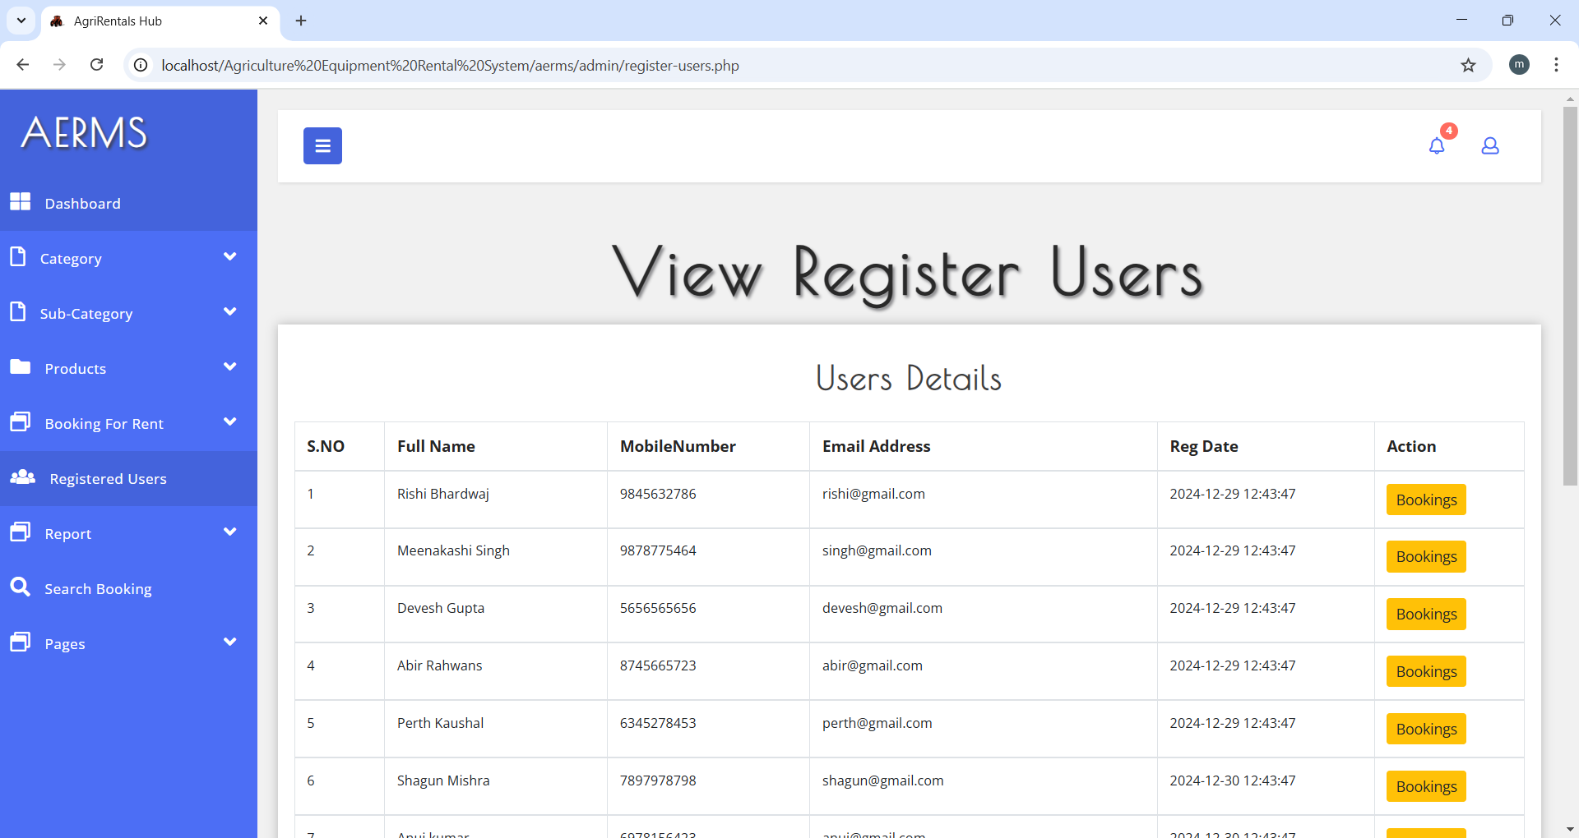
Registered Users

Slide 15
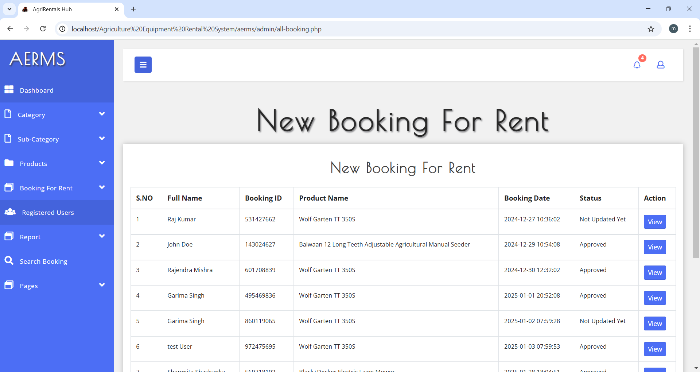
Booking Overview

Slide 16
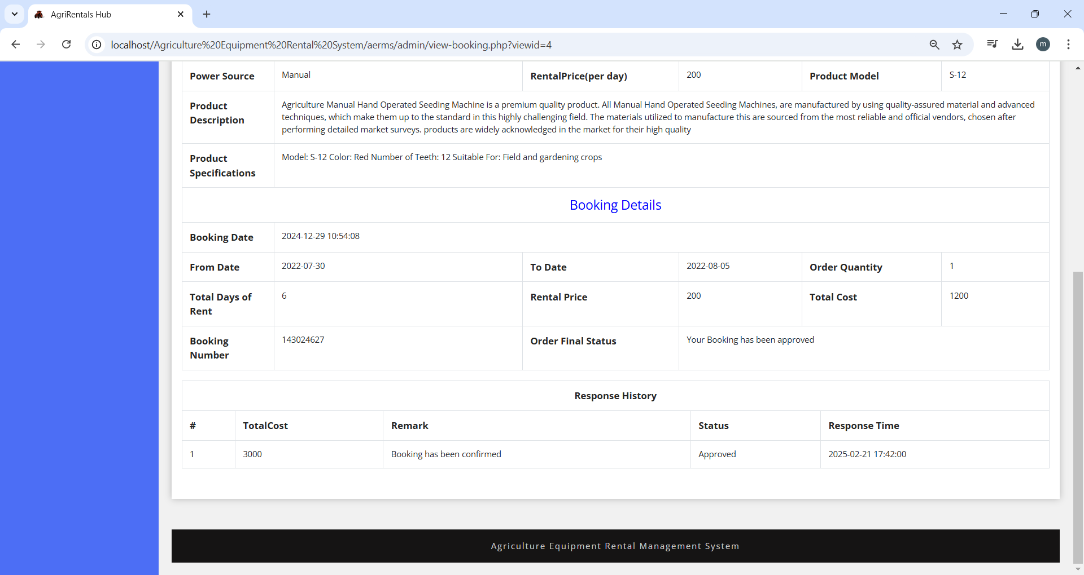
Rental Status - ADMIN

Slide 17
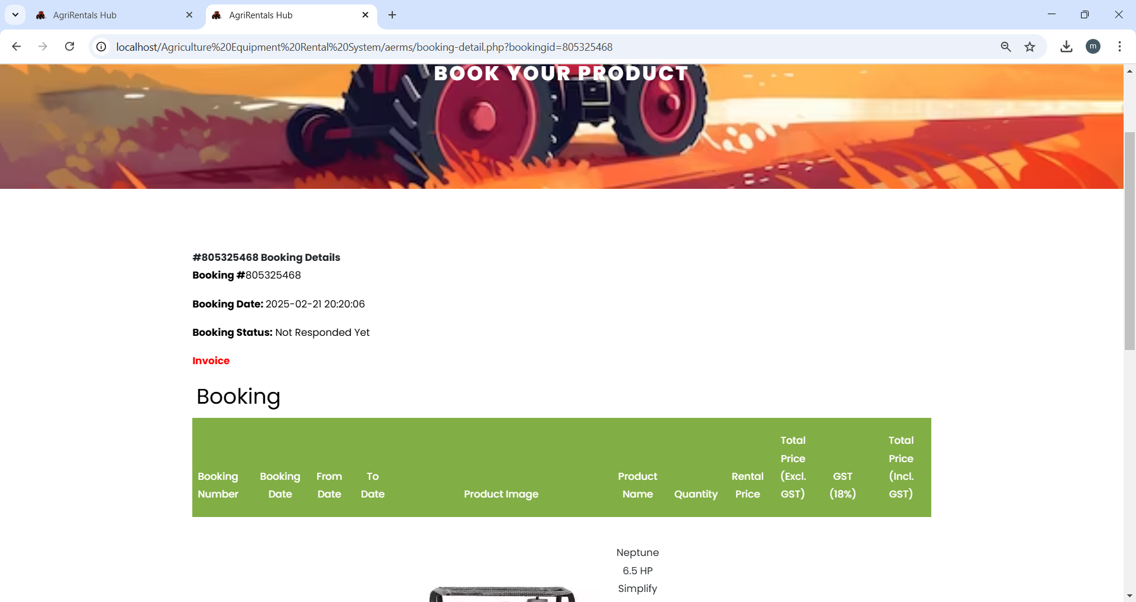
Rental Status -USER

Slide 18
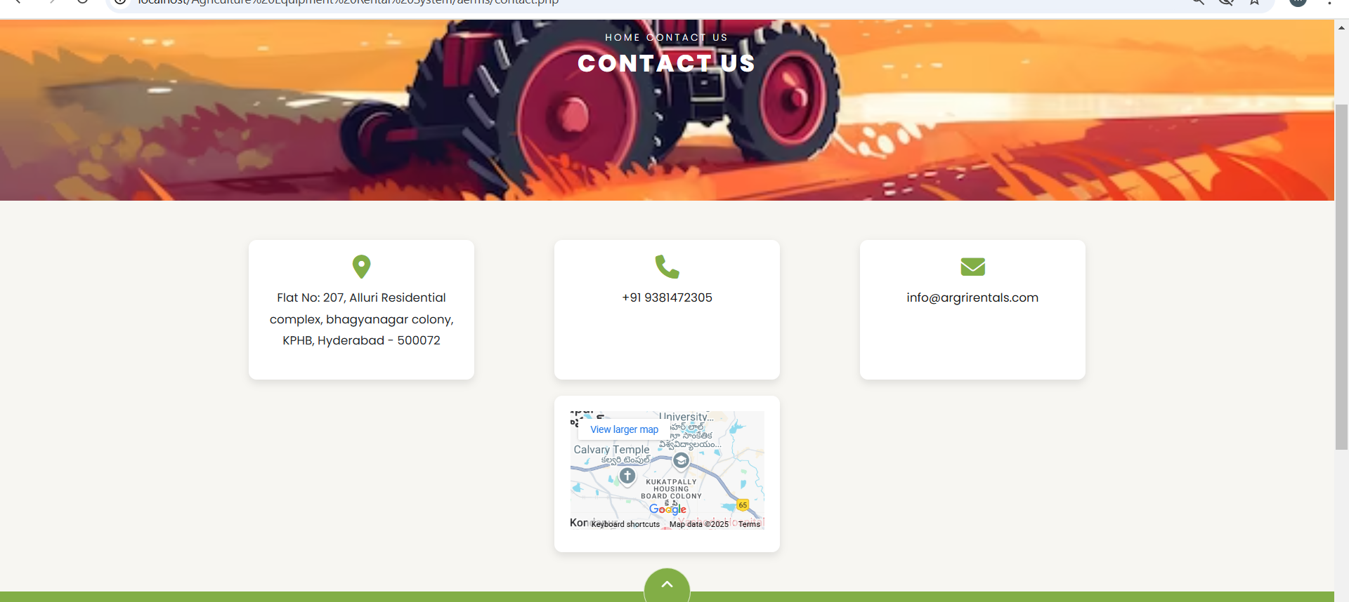
Contact Us
This is the Contact Us page of the Agriculture Equipment Rental Management System. Users can reach out for support, inquiries, or assistance regarding rentals and services.

Slide 19
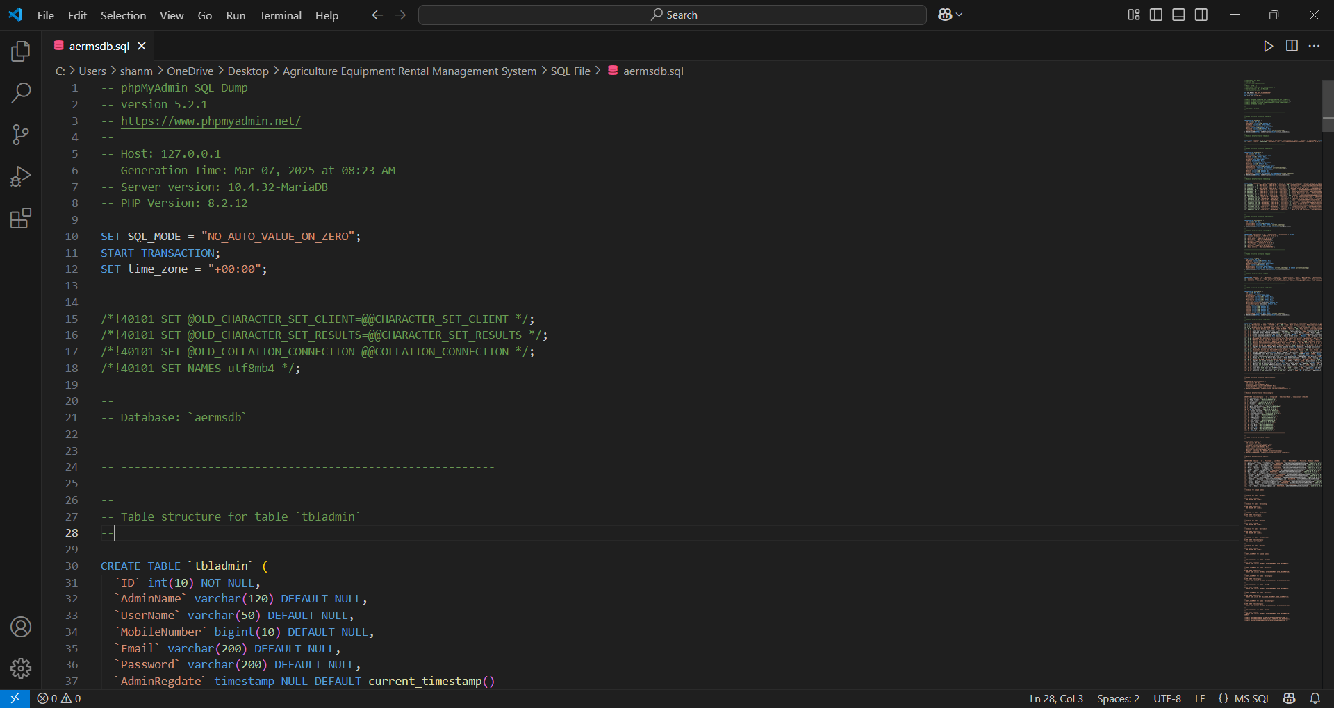
Backend Code :

Slide 20
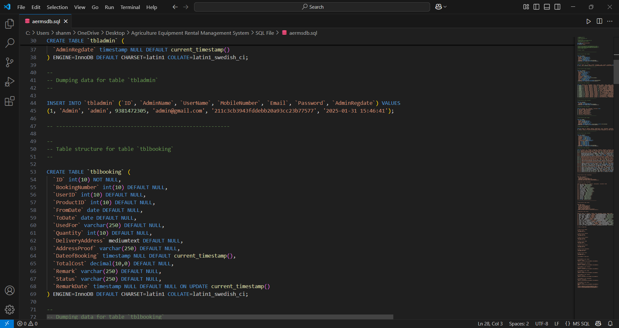

Slide 21
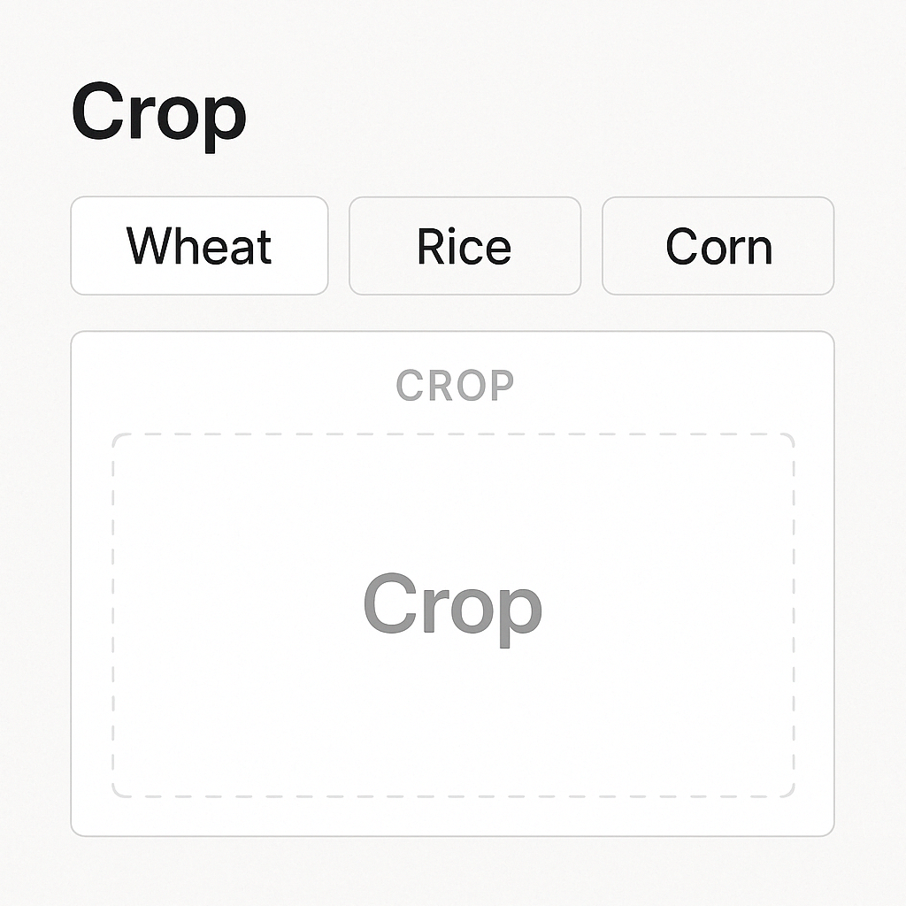

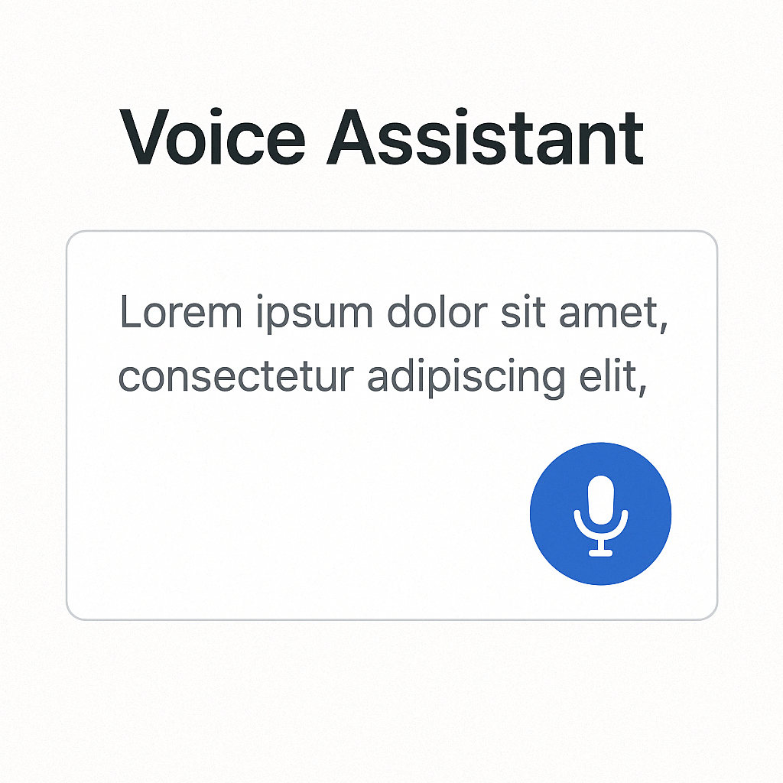
Future Scope
Crop Section
Online Transactions
Voice Assistant

Slide 22
Thank You !!!

